Slide 1
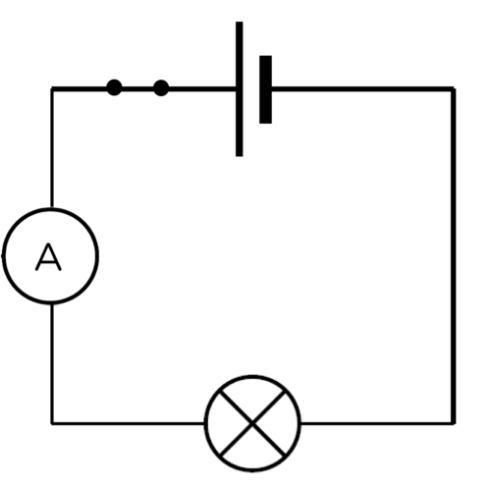
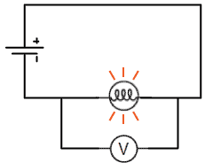
Daily review
CFU 1
Describe electrical current and how it is measured.
Electrical Current
The rate of flow of electric charge past a point.
Ammeter connected in series with the component to measure the current.
Voltage
This difference in potential energy across the globe is called the voltage or potential difference.
Voltmeters are installed in parallel across 2 points of the circuit.
CFU 2
Describe voltage and how it is measured.
CFU 3
Think pair share: differentiate between how a voltmeter and an ammeter is installed in a circuit.

Slide 2
Daily review
CFU 1
Describe what is meant by the term “resistance”
Resistance
A measurement of how difficult it is for charged particles (electrons) to move through it.
The resistance of a circuit can determine the current.
CFU 2
Think pair share: If you had a circuit with high resistance, would you expect the current to be high or low?

Slide 3
Current, Voltage, and Resistance Year 9 Physics

Slide 4
Learning Objectives
CFU
What are we going to learn today?
Use ammeters and voltmeters to measure the current and voltage in a circuit.
Activate Prior Knowledge
Look at the circuit diagrams.
Is an ammeter connected in series or parallel?
Is the volt meter connected in series or parallel?

Slide 5
Concept Development
CFU 1
What do all components in circuits have?
Connecting Ammeters and Voltmeters
In an electric circuit all components have a positive side and a negative side.
This is determined by the way that the leads are connected.
The way that some components are connected makes no difference.
E.g. globes/resistors
However when installed incorrectly, voltmeters and ammeters can break easily.
CFU 2
What does this determine in the circuit?
CFU 3
What can happen when components are installed incorrectly?
Vocabulary
Electric Charge: charged particles, in a circuit this is usually negative electrons.

Slide 6
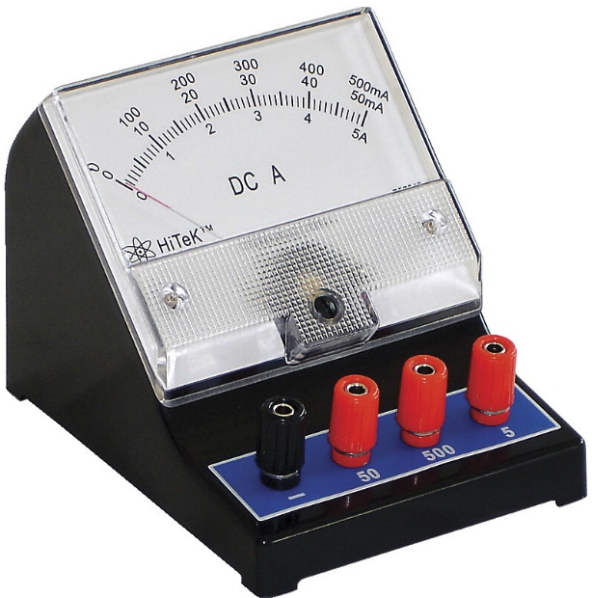
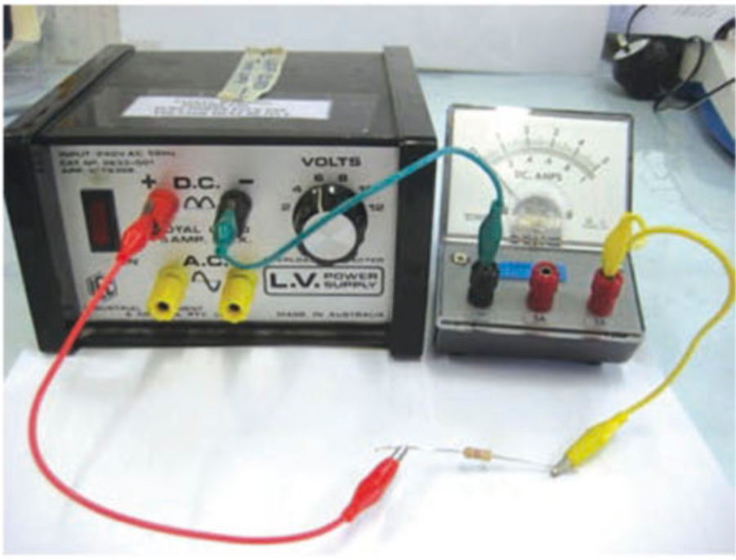
Concept Development
Connecting Ammeters and Voltmeters
The ammeters we use have a black terminal, and multiple red terminals.
The black terminal must always be connected to the lead coming from the NEGATIVE side of the power pack.
Only one red terminal is ever used at a time. Start with the one on the RIGHT and if the needle barely moves, move to the left one at a time.
CFU 1
Which side does the black terminal connect to on the power pack?
CFU 2
Which red terminal do you connect first on the ammeter?

Slide 7
Concept Development
Reading Ammeters and Voltmeters
Our ammeters and voltmeters have multiple scales on them.
You read the one that matches the red terminal you have connected the circuit to.
E.g. 5A terminal, use the scale ending in 5A.
CFU 1
If the lead was connected to the middle red terminal, which scale would you read?

Slide 8
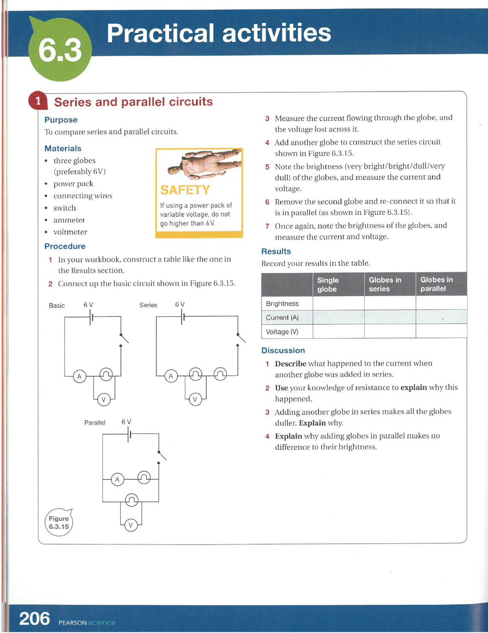
Guided practice
Collect a print out of the experiment from your teacher, or download from connect.
Read the ENTIRE worksheet before starting the experiment.
If you are unsure about any of the circuits, ASK YOUR TEACHER FOR HELP.

